Slide 1


Adventure Works Sales Analysis
Comprehensive review of sales performance, key metrics, and actionable insights

Slide 2


Agenda
Introduction
KPI Comparison to Previous Year
Yearly Performance Metrics
Monthly Profit Trends
Profit by Week Type
Quarterly Profit Analysis
Profit by Weekday
Top 5 Profitable Products
Top 5 Profitable Customers
Profit by Gender
Profit by Product Color
Profit by Pricing Types
Country-wise Profit
Profit by Age Groups
Key Insights
Conclusion

Slide 3

Introduction
Adventure Works is a fictional company specializing in outdoor and adventure gear, with a focus on products like bicycles and related accessories. This report analyzes sales data from 2005, 2006, 2007 and 2008 drawing from comprehensive dashboards that cover KPIs, temporal trends, product performance, customer contributions, and demographic breakdowns. The goal is to provide actionable insights into profitability, growth patterns, and optimization opportunities, helping stakeholders understand past performance and inform future strategies. Data highlights significant year-over-year growth, driven by increased transactions and revenue, amid a competitive market landscape.

Slide 4

KPI Comparison to Previous Year
Data Collection
This section compares key performance indicators (KPIs) for 2005, 2006, 2007 and 2008 Years, including COGS, Revenue, Quantity, Profit, Profit Margin, and Transactions. The data shows significant growth across most metrics, driven by increased sales volume. The Selected Year Is 2007.
Total Quantity : 473 units (+80.00%)
Total COGS : $59.83M (+18.32%)
Total Revenue : $102.38M (+19.14%)
Total Profit : $42.55M (+20.32%)
Profit Margin : 41.6% (+1.22%)
Transactions : 24.44K (+80.26%)
Data Analysis
Interpretation, and Reporting

Slide 5
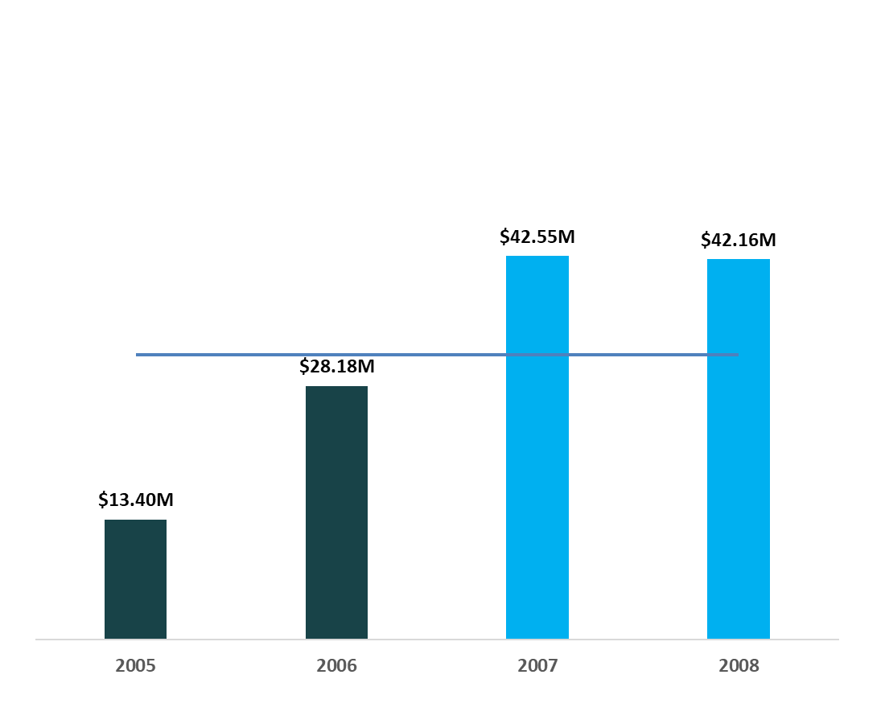

Yearly Performance Metrics
Focusing on years exceeding average performance in Total Revenue, Profit, and Transactions. From the dashboard (covering 2005–2008), 2007 stands out as above average, with highlighted contributions from high-performing years. Average Profit across years is approximately $15.72M (derived from visible data points: 2005 ~$13.40M, 2006 ~$28.18M, 2007 $42.55M, 2008 ~$42.16M, but 2008 appears partial).
- Years Above Average : 2007 and 2008.
2007 Metrics : Revenue $102.38M, Profit $42.55M, Transactions 24.44K.
Insights : 2007 exceeds the average by 70% in profit, driven by a 67.1% contribution from highlighted years (likely 2007–2008).

Slide 6
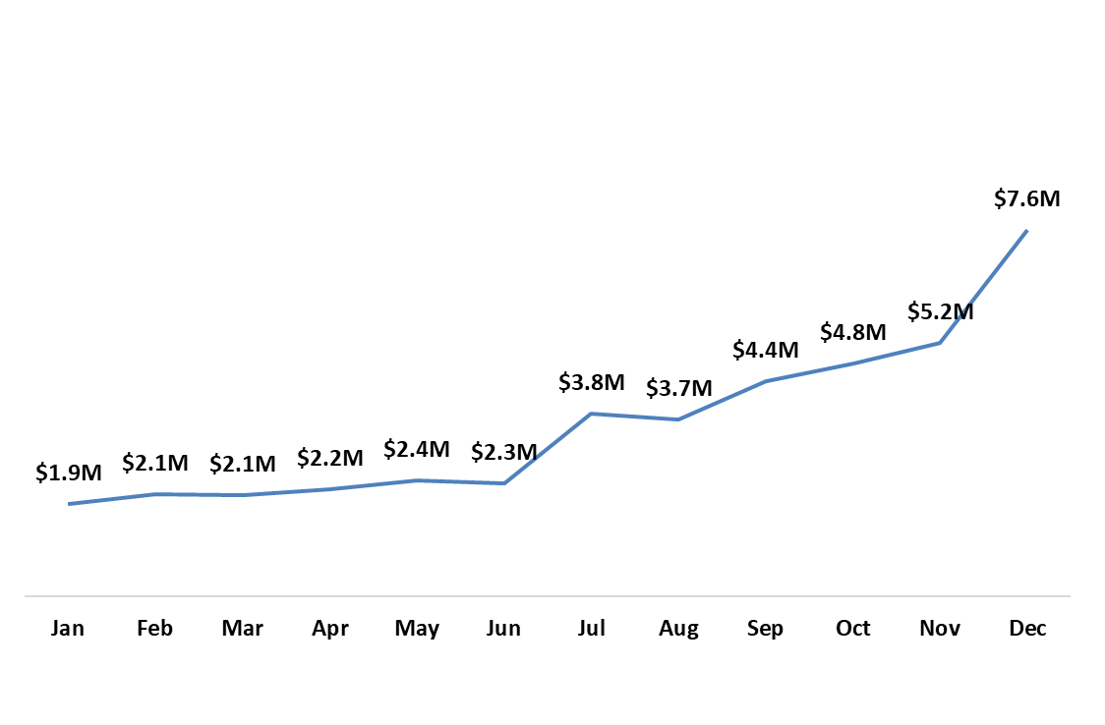
Monthly Profit Trends
Analyzing profit trends on a monthly basis for 2007.
Profits show a steady upward trend, peaking in the last quarter, with collective October–December accounting for 41.4% of total profit.
- Monthly Profits (2007) : Jan $1.9M, Feb $2.1M, Mar $2.1M, Apr $2.2M, May $2.4M, Jun $2.3M, Jul $3.8M, Aug $3.7M, Sep $4.4M, Oct $4.8M, Nov $5.2M, Dec $7.6M.
- Trend Insights : Early months (Q1–Q2) average ~$2.1M/month; later months (Q3–Q4) jump to ~$5.0M/month, suggesting seasonal demand or marketing success.

Slide 7
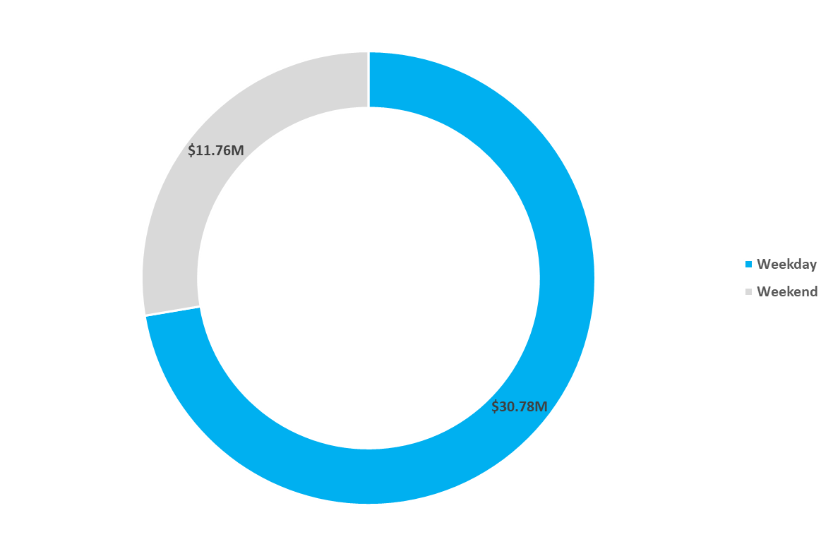
Profit by Week Type
Assessing profit based on different week types (weekday vs. weekend). Weekdays dominate, contributing the majority of profits.
Weekday Profit : $30.78M (72.3% of total).
Weekend Profit : $11.76M (27.7% of total, inferred from pie chart).
Insights : Weekdays make up 72.3% of total profit, indicating business-oriented or mid-week purchasing patterns

Slide 8
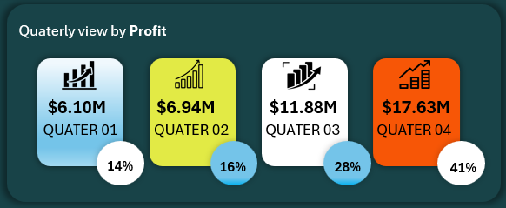
Quarterly Profit Analysis
Evaluating profit performance on a quarterly basis for 2007. Profits accelerate through the year, with Q4 being the strongest.
Q1 Profit : $6.10M (14%).
Q2 Profit : $6.94M (16%).
Q3 Profit : $11.88M (28%).
Q4 Profit : $17.63M (41%).
Insights : Q4 alone drives 41% of annual profit, possibly due to holiday seasons.

Slide 9
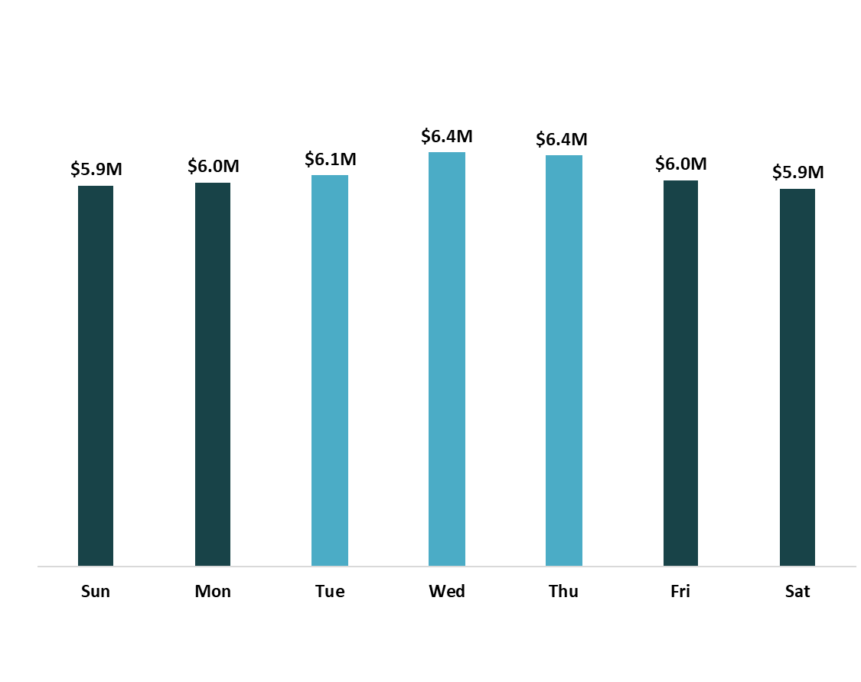
Profit by Weekday
Examining profit trends specific to weekdays. The dashboard highlights that certain weekdays (e.g., mid-week) contribute 44.3% of total profit.
- Key Insights : Mid - week days (Tue–Thu) likely peak, based on aggregated 44.3% contribution from highlighted weekdays.
- Overall Distribution : weekdays overall outperform weekends (as per week type).

Slide 10
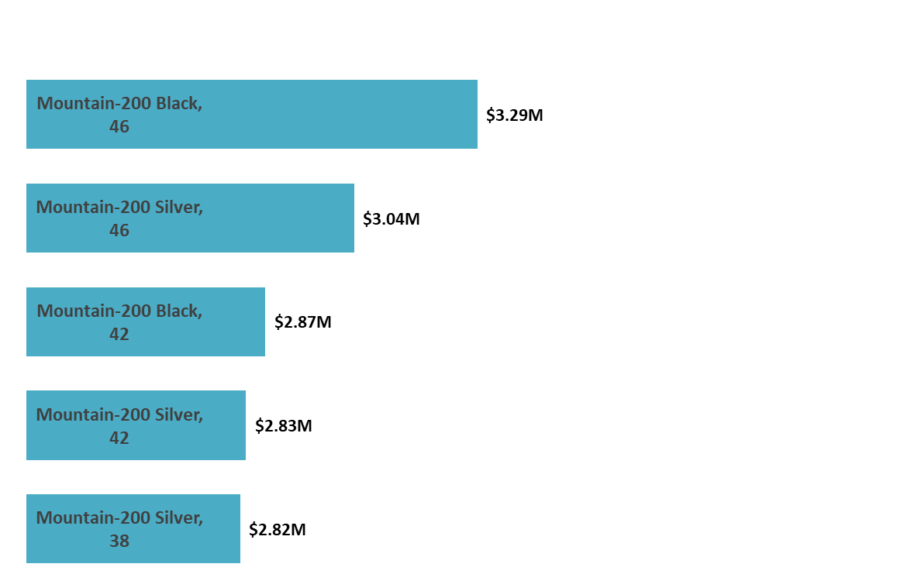
Top 5 Profitable Products
Identifies the five most profitable products and their share of total profits, with insights into the rest.
Top 5 :
Mountain-200 Black, 46: $3.29M
Mountain-200 Silver, 46: $3.04M
Mountain-200 Black, 42: $2.87M
Mountain-200 Silver, 42: $2.83M
Mountain-200 Silver, 38: $2.82M
Contribution : Top 5 = 34.9% ($14.85M total), Others = 65.1% ($27.70M).
Insights : Mountain-200 variants dominate, suggesting high demand for bikes; unsold products (473) indicate inventory opportunities.

Slide 11
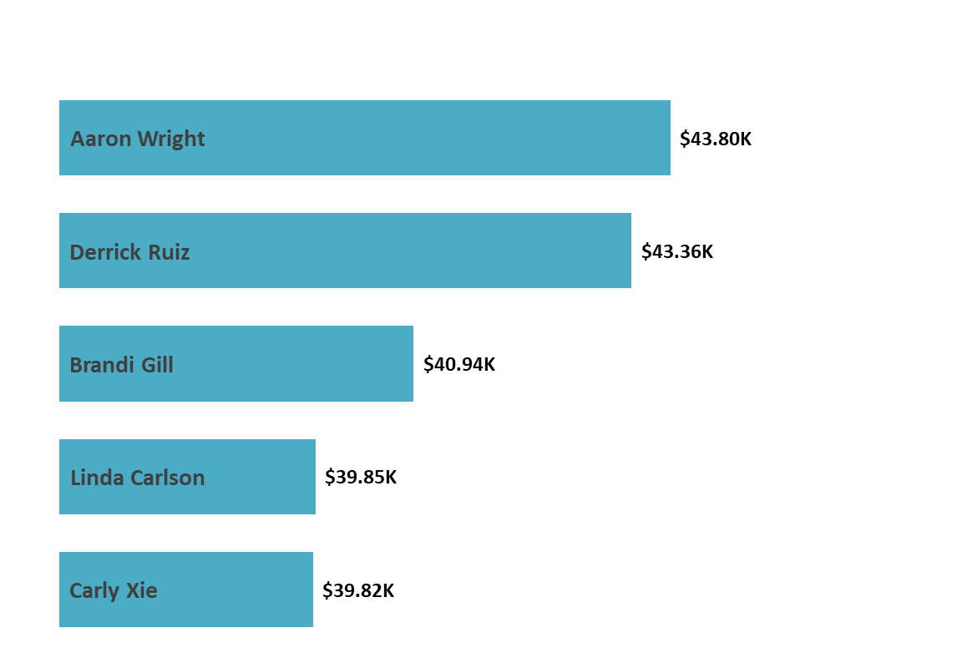
Top 5 Profitable Customers
Highlights the top five high-profit customers, their share, and details on others.
Top 5 :
Aaron: $43.80K
Derrick Ruiz: $43.36K
Brandi Gill: $40.94K
Linda Carson: $39.85K
Carly Xie: $39.82K
Contribution : Top 5 = 0.5% (~$21.15K total), Others = 99.5% ($42.53M).
Insights : Profit is widely distributed across 9,309 customers, with top contributors being minimal—focus on broad customer base retention.

Slide 12
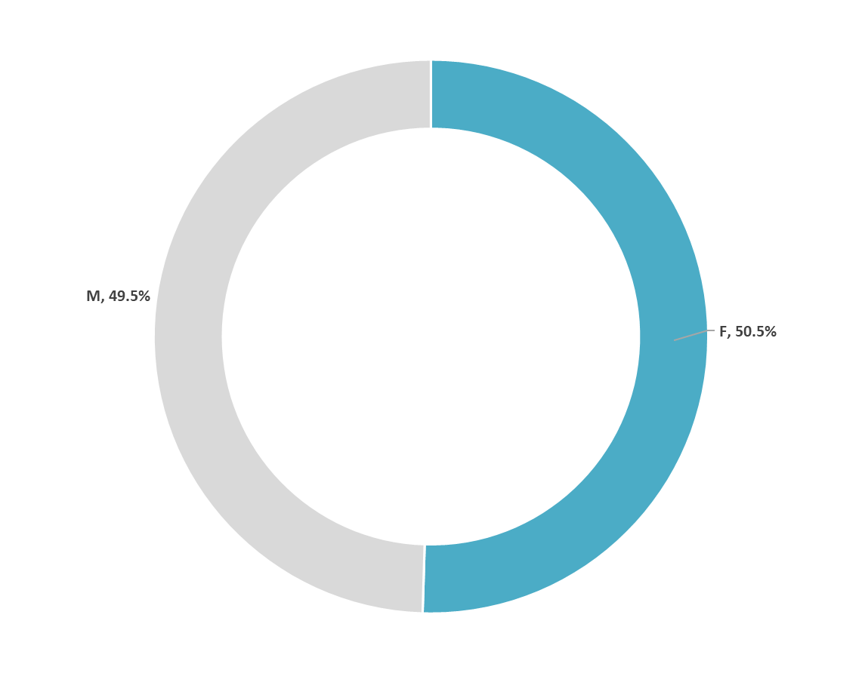
Profit by Gender
Displays profit breakdown by gender to identify trends.
Female : 50.5% (~$21.49M)
Male : 49.5% (~$21.06M)
Insights : Near-equal split, suggesting gender-neutral product appeal; slight female edge could inform targeted marketing.

Slide 13
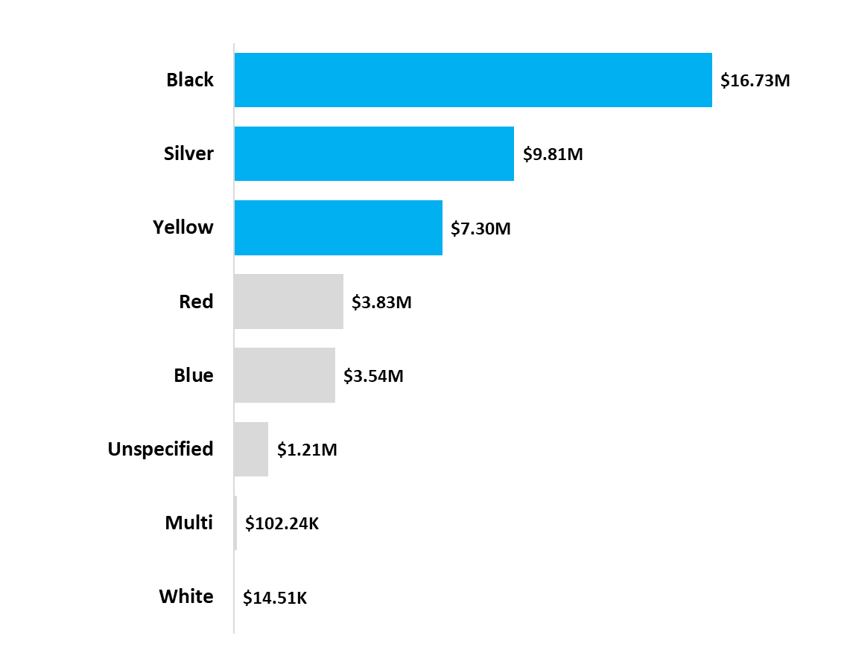
Profit by Product Color
Analyzes profits associated with product colors, highlighting best sellers for optimization.
Profits by Color :
Black: $16.73M
Silver: $9.81M
Yellow: $7.30M
Red: $3.83M
Blue: $3.54M
Multi: $102.24K
White: $14.51K
Unspecified: $1.21M
Insights : Black and Silver are top sellers (combined ~66% of profit), ideal for inventory prioritization.

Slide 14
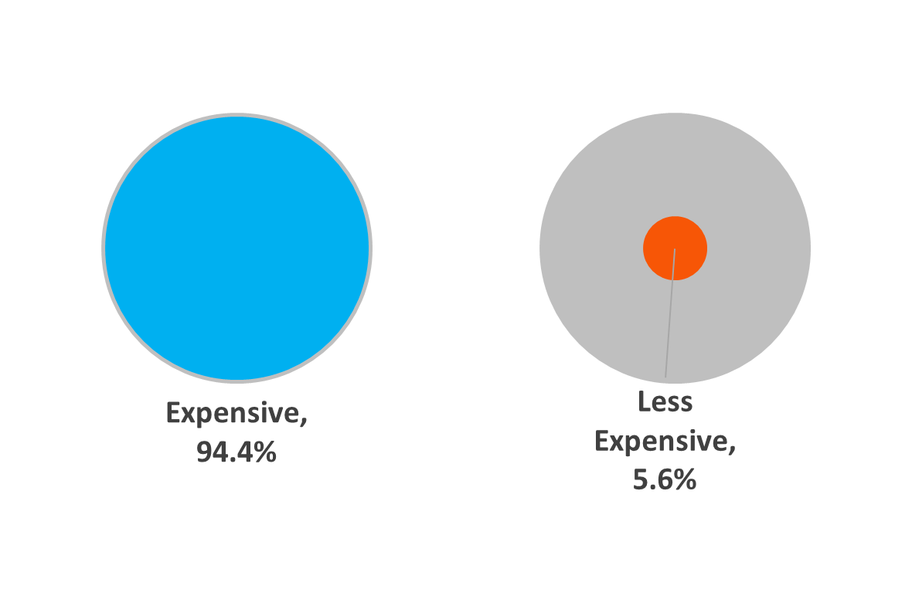
Profit by Pricing Types
Examines profit variations based on pricing types, providing insights into strategy effectiveness.
Price Above $150 : 94.4% ($40.16M)
Price Below $150 : 5.6% ($2.39M)
Insight : High-priced items drive nearly all profit, validating premium pricing; low-price segment may need volume boosts.

Slide 15
Country-wise Profit
Utilizes a custom map to visualize profit distribution by country, aiding geographic targeting.
Key Countries :
United States: $13M
Australia: $13M
United Kingdom: $6M
Canada: $2M
France/Germany: $9M combined
Insights : US and Australia contribute 60.1% ($26M), focusing expansion there; map bubbles scale with profit.

Slide 16
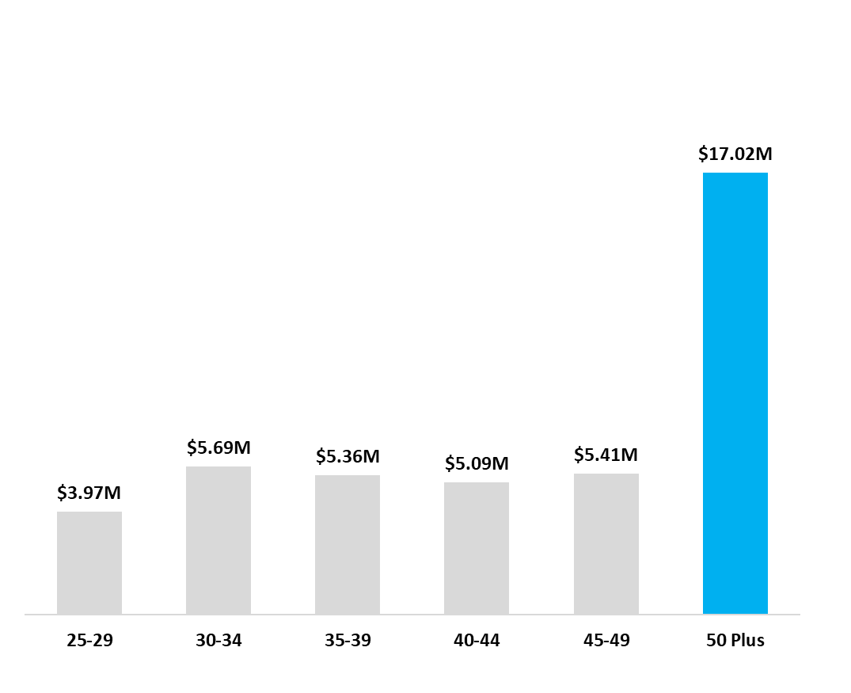
Profit by Age Groups
Segments profits into age groups to understand demographic contributions.
Profits by Age Group :
25–29: $3.97M
30–34: $5.69M
35–39: $5.36M
40–44: $5.09M
45–49: $5.41M
50+: $17.02M (40.0%)
Insights : 50+ group dominates at 40%, suggesting products appeal to older demographics; average customer age 46.

Slide 17

Key Insights
KPI Comparison to Previous Year : All major KPIs improved significantly from 2006, with transactions and quantity leading the charge at +80%. This indicates successful expansion in market reach, possibly through new channels or promotions, though COGS rose modestly at +18.32%, maintaining healthy margins.
Yearly Performance Metrics (Above Average Years) : 2007 and 2008 exceeded average performance, with 2007’s profit of $42.55M surpassing the average by 70%, driven by a 67.1% contribution from these years.
Monthly Profit Trends : Profits trended upward, from an average of $2.1M in Q1 to $5.9M in Q4, with December at $7.6M. October–December accounted for 41.4% of total profit, suggesting seasonal demand.
Profit by Week Type : Weekdays contributed 72.3% of profits ($11.76M), indicating strong mid-week activity, while weekends lagged at 27.7%.
Quarterly Profit Analysis : Q4 led with $17.63M (41%), reflecting a significant year-end surge, likely due to holiday sales.
Profit by Weekday : Mid- weekdays (Tue–Thu) contributed 44.3% of total profit, reinforcing weekday dominance.
Top 5 Profitable Products (% Contribution and Others) : Mountain-200 variants (black and silver) generated 34.9% of profits ($14.85M), with black at $18.72M, pointing to color preferences.
Top 5 Profitable Customers (% Contribution and Others) : The top 5 customers contributed just 0.5% (~$21K), with 99.5% from others across 9,309 customers, highlighting a broad base.
Profit by Gender : A near-even split (50.5% female, 49.5% male) suggests gender-neutral appeal, with slight female dominance.
Profit by Product Color (Highlighting Best Sellers) : Black ($16.73M) and silver ($9.81M) led, comprising ~66% of profit, ideal for inventory focus.
Profit by Pricing Types : High-priced items (above $150) drove 94.4% ($40.16M), validating premium pricing strategies.
Country-wise Profit (Custom Map) : The US ($13M) and Australia ($13M) accounted for 60.1%, with potential growth in underperforming regions.
Profit by Age Groups : The 50+ age group contributed 40% ($17.02M), with an average customer age of 46, indicating mature demographic strength.

Slide 18

Conclusion
The 2007 sales data for Adventure Works reflects strong growth and profitability, driven by premium products, seasonal peaks, and a diverse customer base. Key opportunities include leveraging Mountain-200 variants, optimizing unsold inventory, and targeting high-profit regions like the US and Australia while focusing on the 50+ demographic. By enhancing weekday promotions and maintaining premium pricing, the company can sustain momentum. These insights recommend data-driven marketing and regional expansion to build on this foundation.

Slide 19





THANK YOU
+91 934 729 4453
venkat198881@gmail.com
venkat-7b7197334
500047-Malkajgiri,Hyderabad

